Slide 2
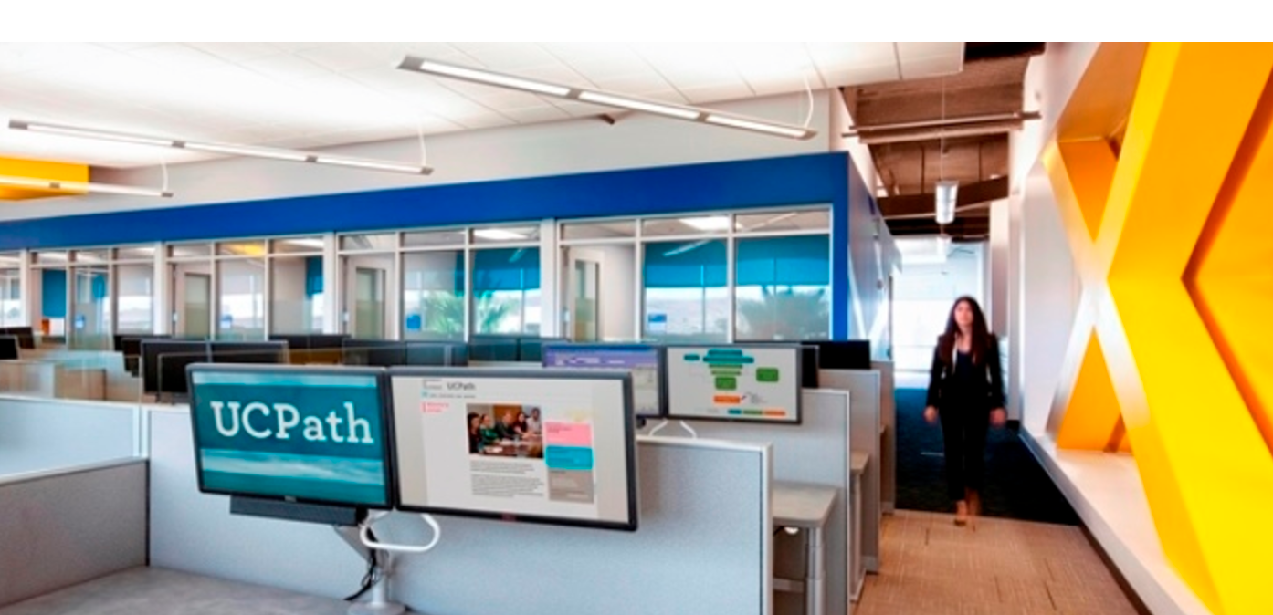
UCPath is here…..
The UCPath system, UCPath center and a new system to initiate all payroll related work at UCM will be live January 2nd 2018.

Slide 3
UCPath
New Payroll System
New Business Processes
UCPath Center
What is UCPath at UCM?
PPS is 35 years old and failing.
UCPath is an opportunity to re-think how we do work and to standardize our processes.
UCPath will deliver access to the data and reports we need to work smarter.

Slide 4
UCPath at UC Merced
UCPath – The PeopleSoft System
Replacement of PPS and SLS Systems with UCPath (PeopleSoft)
UCM Path-Team Led by Emily Bustos
Large Scale Data Migration
Tolerance is $.05
UCPath Program = UCPath System + Campus Personnel Workflow

Slide 5
Personnel Landscape
UCPath
Halogen
All work required in the administrative management of employees.
GLAAS
?
Unknown
OnBase
Hire
Academic
Non-Academic
Routine
Adjust
One-time
Perform.
Evaluate
Improve
Terminate
Voluntary
Involuntary
Absence
Medical
Military
Sabbatical
Disciplinary
Pay
Develop
Reclassify
Onboard
?
?
?

Slide 6
Modernizing Systems and Processes

Slide 7
Currently at UC Merced
Request Data Collection & Approvals
Request Form Submission
Request Transaction
Request Fulfillment
Business Officer
School
APO
HR CoE
Dept
ACT
Business Officer
Variable on Process
Operating Units
HRPC
Payroll System

Slide 8
How Does UCPath Work at UC Merced?
Request Data Collection & Approvals
Request Form Submission
Request Transaction
Request Fulfillment
Business Officer
School
APO
HR CoE
Dept
ACT
Business Officer
Variable on Process
3 Days
3-5 Days (Typ)
3-5 Days (Typ)
Operating Units
HRPC
Path Center

Slide 9
How Does UCPath Work at UC Merced?
Request Data Collection & Approvals
Request Form Submission
Request Transaction
Request Fulfillment
Business Officer
School
APO
HR CoE
Dept
ACT
Business Officer
Spring Semester
12/6 Launch
12/6 Launch
3-5 Days (Typ)
OnBase Automated Workflow
OnBase Forms
UCPath

Slide 10
UCPath Program Schedule
PPS Freeze
Overview
Follow-Up
1st UC Path Pay
OnBase WorkFlow Training
Sep 28
Nov 1
Dec 6
Jan 2
Apr 2
2017
Jul
Aug
Sep
Oct
Nov
Dec
2018
Feb
Mar
Apr
May
Jun
2018
Today
Training (End to End Operations)
Outcome
Administrative teams responsible for implementing the new system
and standardized processes are prepared to deliver services.
WHO
HRPC
Business Officers
Supervisors
Management
UC Path – PeopleSoft (Readiness)
System Design & Configuration
HRPC Training -PeopleSoft
Led by Path Center and UCM’s Technical Team.
Work Flow (Readiness)
Led by BFSI
Mapping Internal UCM Processes and aligning to UC Path Data Requirements.
Standard Forms – OnBase Training
Led by BFSI & OIT & UCM Technical Team
Meet with HRPC, HR, APO and Business Officers to train on requisite data and approvals for new standardized forms.
Automate Workflow – OnBase Training
Led by BFSI & OIT & UCM Technical Team
Enable automatic workflow to capture relevant data and approvals as it proceeds internally, filling the standard form automatically.
Orientation (Paycheck Recipient)
Outcomes
All campus personnel will be aware and educated
on what UC Path is and why its important.
Responsibilities for self management of personal data through self service portal is understood.
Aware of Orientation/Training Material.
Know where to seek assistance in the transition.
Inform Sessions
Presentations on UCPath Go-Live
Inform Sessions
Presentations on UCPath Go-Live
WHO
Faculty
Staff
Students
Engagement Sessions
Targeted Discussions
Campaigns
Data Veracity
Direct Deposit
Campaigns
Self-Service Portal

Slide 11
Next Steps?
Personal information updated via AYSO
Sign up for Direct Deposit!
Training will start in November and go through January
UCPATH@UCMERCED.EDU UCPATH.UCMERCED.EDU

